Slide 1
Academic Integrity
Northern College

Slide 2
Student Awareness
Teaching
Instructor Tools
Policies and Procedures
Students need to be aware that instructors will be vigilantly looking for the use of Artificial Intelligence and have tools to help identify the use of it
Students must be aware of the policies and procedures in place – especially the repercussions of Academic Dishonesty.
What Academic Integrity is
How students can use tools such as Grammerly and Artificial Intelligence appropriately

Slide 3
Student Instruction
Use every opportunity to share Academic Integrity information with students.
All Communications I students will complete four Academic Integrity Modules at the beginning of the course. The modules cover:
What Academic Integrity is
Strategies to help students succeed
Tools to assist students write better and recognize when they have violated academic integrity
Overview of Policies and Procedures

Slide 4
All members of the college community share responsibility for upholding the academic standards and reputation of the college. Academic integrity is the cornerstone to the acquisition of knowledge, founded on principles of respect for knowledge, truth, scholarship, and acting with honesty.
Policies and Procedures
Academic Policy #A-24

Slide 5
Upholding academic integrity is a condition of continued membership in our college community. Each student is responsible for his or her conduct as it affects this college community.
Academic dishonesty is unfair and discouraging to the majority of students who pursue studies honestly.

Slide 6
Instructors
01
02
03
Recognizing use of AI
Follow AI Policy and Procedures
Help students use AI appropriately.
04
05
Make Assignments AI Resistant
Use AI as a tool to develop content and resources.

Slide 7
Discussion Question
How will/do you recognize that use of AI?
?
Notes:
https://chat.openai.com/
LEID@northern.on.ca
Northern123
https://tome.app/leid-5c8?tab=recent

Slide 8
Recognizing Use of AI
Writing is far better than the original sample provided
Sources do not match the citation
Consistency and repetition
Discussion and behaviour
Monitoring tools
Notes:
Consistency and Repetition
AI-generated content can sometimes exhibit a level of consistency or repetition that's not typical of human-generated work. Look for patterns that seem unnatural or automated.

Slide 9
Policies and Procedures
ACADEMIC POLICY #A-24
Academic Integrity Report
Remediation?

Slide 10
Discussion Question
How can students use AI appropriately?
?

Slide 11
AI Friendly Assignments
Have AI write using prompts and use tracking to see changes made by students.
Answer Why?
Students critique AI-generated work
Have AI write using student adds localization based on class content.
Students develop questions to ask an AI
Have students get feedback on writing from AI

Slide 12
Discussion Question
How can we make assignments AI resistant
?

Slide 13
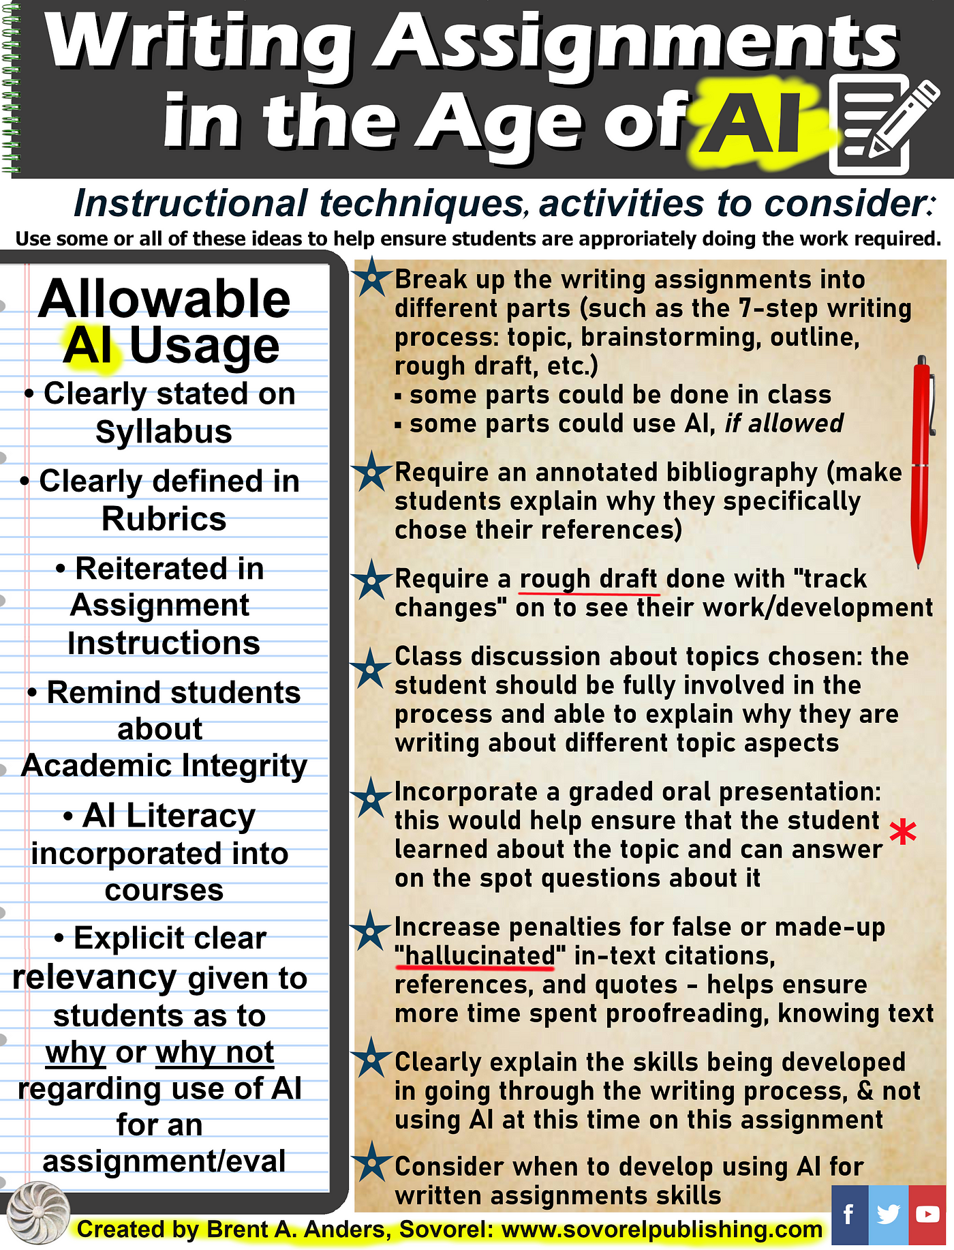

Slide 14
AI Resistant Assignments
01
02
03
Be Current
Require current/modern events/resources
Be Local
Incorporate information from classes, regional information, etc.
Be Personal
Ask for personal feelings, experiences, opinions
04
02
03
Discuss
Expected to answer the how/why
Use Active Pedagogies
Student Presentations & Videos, debates, group work, PBL, Role Play, Games, Flipped Classrooms
Images and Videos
Have students critique videos or describe images.
Notes:
Be current – most AI’s do not have access to anything newer then 2021
Sources: Author: Brent A. Anders
https://sovorelpublishing.com/index.php/author/brent/

Slide 15
Discussion Question
How can Instructors use AI?
?

Slide 16
